Slide 1
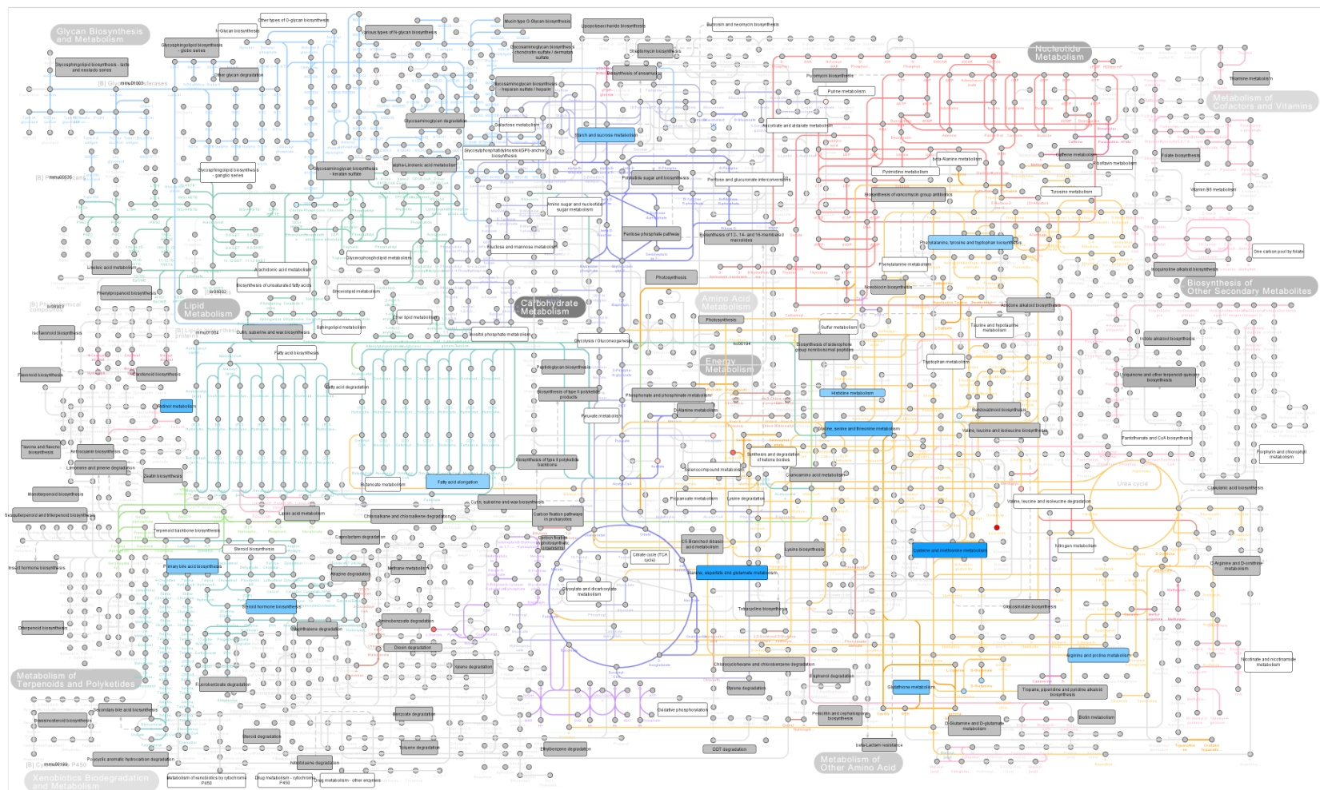
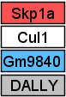
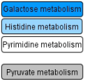
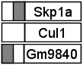
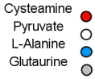
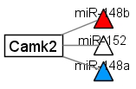
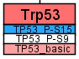
A
B
C
D
Data types
high significance
upregulated
small significance
mRNA
no difference
Pathway
non significant
downregulated
contains no significant feature
no data
DNAm
hypermethylated
Metabolite
Taurine
Pyruvate
L-Alanine
Acetate
same colors as mRNA
no difference
hypomethylated
miRNA
mRNA target
same colors as mRNA
Protein
same colors as mRNA
Color keys
p-value (e.g. Pathway)
log₂ fold change (e.g. Metabolite)
-1.5
0
1.5
0.0005
0.05

